Slide 1
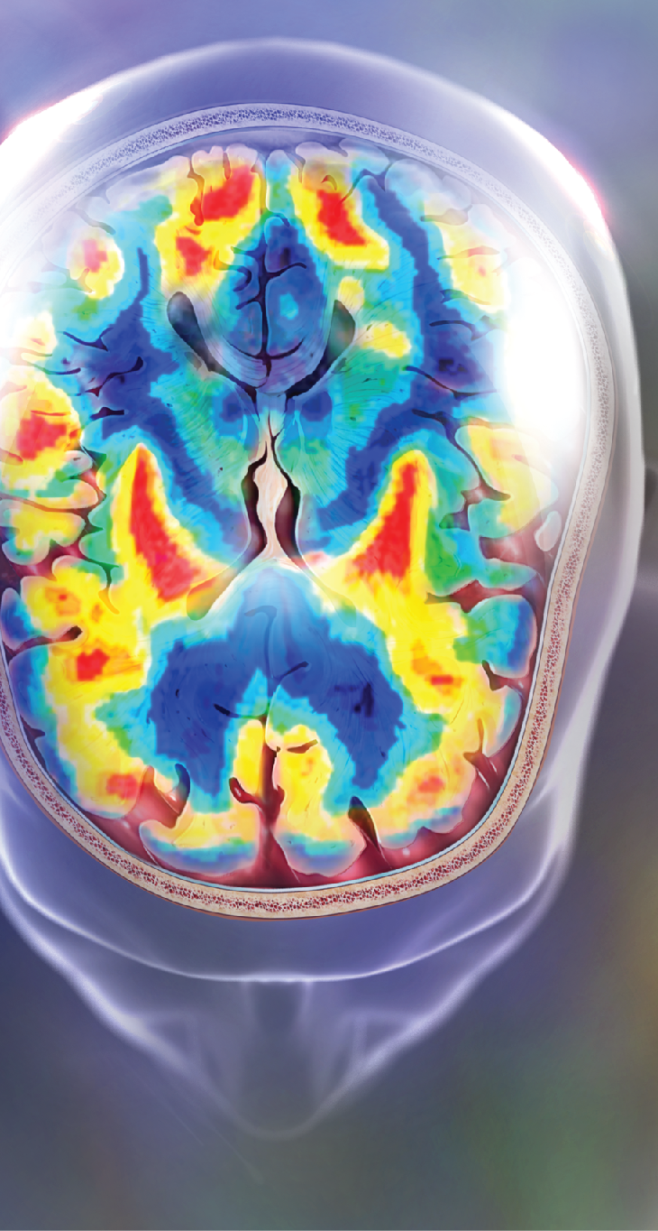

Healing the
Troubled Mind
How Do Psychologists Provide Therapy?
What Different Types of Psychotherapies Are Used?
What Are Biological Therapies?
How Are Specific Disorders Treated?
Notes:
How Do Psychologists Provide Therapy?
What Different Types of Psychotherapies Are Used?
What Are Biological Therapies?
How Are Specific Disorders Treated?
Note about the image on this slide: Both medication and behavioral treatments reduce abnormal activity in the basal ganglia associated with obsessive-compulsive disorder.

Slide 2


How Do Psychologists Provide Therapy?
L01
Summarize the core principle and steps of evidence-based practice in psychotherapy, apply the steps to an example case.
L02
L03
Differentiate the training/licensure required for, and types of care offered by, psychiatrists, clinical psychologists, counselors, hypnotherapists,
and life coaches.
L04
L05
Notes:
LO1: Summarize the core principle and steps of evidence-based practice in psychotherapy, apply the steps to an example case.
LO2: Differentiate the training/licensure required for, and types of care offered by, psychiatrists, clinical psychologists, counselors, hypnotherapists, and life coaches.

Slide 3




Psychotherapy
7.2
© Alina Solovyova-Vincent/iStockphoto
© Frank Pedrick/The Image Works
4.84
© Will & Deni McIntyre/Photo Researchers/Getty Images
© All Photos on content slides require a photo credit
Courtesy of Mountain Employee Assistance Program
4.84
L01
L02
L03
L04
L05
How Do Psychologists Provide Therapy?
What Different Types of
Psychotherapies Are Used?
What Are Biological Therapies?
How Are Specific Disorders Treated?
Notes:
Psychotherapy is the use of conversation between a therapist and one or more clients to improve symptoms of psychological disorder. This distinguishes psychotherapy or “talk therapy” from biological approaches. A variety of licensed professionals can perform psychotherapy; in many states only MDs can use biological approaches.
One-on-one therapy typically involves hour-long meetings between therapist and client, with treatment anywhere from a few weeks to several years. Therapists can also work with groups of clients, especially when clients can learn from each other’s experience or provide mutual support, or with couples or families. Online therapy is also becoming increasingly popular, and studies suggest that it can be quite effective.

Slide 4

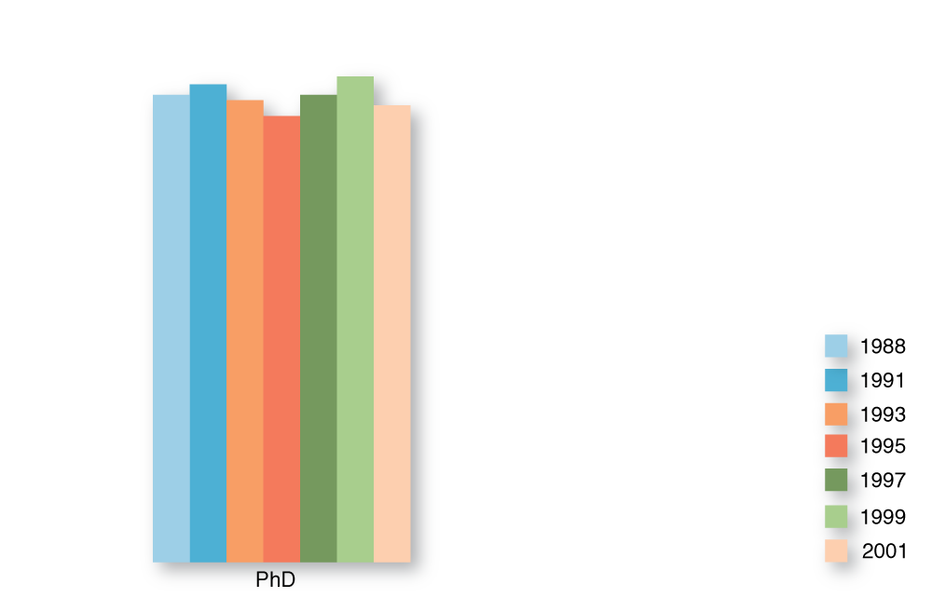

Clinical Psychologists:
Doctoral Level
© Cengage Learning 2013
L01
L02
L03
L04
L05
How Do Psychologists Provide Therapy?
What Different Types of
Psychotherapies Are Used?
What Are Biological Therapies?
How Are Specific Disorders Treated?
Notes:
A “psychologist” has obtained an advanced degree (masters or doctoral) in psychology. Not all psychologists are qualified to practice as psychotherapists. Many Psychology PhDs are trained primarily for research. At the doctoral level, those with a PhD in Clinical Psychology completed a program that includes both extensive research training and clinical training. In some states, licensed clinical psychologists may also obtain extensive added training, allowing them to prescribe medications.
Some programs, typically offered by private professional schools rather than research universities, offer a Doctor of Psychology or “PsyD” degree. These programs teach students to be informed consumers of psychology research, but conducting research is not emphasized. Instead, the emphasis is strongly on clinical practice. While PhD degree rates (including “pure” research as well as clinical degrees) have been fairly constant in the last 20 years, PsyD programs have become increasingly popular.

Slide 5










Clinical Psychologists:
Masters Level
© Cengage Learning 2013
L01
L02
L03
L04
L05
How Do Psychologists Provide Therapy?
What Different Types of
Psychotherapies Are Used?
What Are Biological Therapies?
How Are Specific Disorders Treated?
Notes:
A variety of Master’s degrees also train one to practice psychotherapy, including the Masters in Social Work (MSW), in Family and Child Counseling (MFCC), some Masters in Psychology, and the Master of Divinity (MDiv). While only a third of those who graduate with a Bachelor’s Degree in Psychology are able to work directly in the mental health field, more than 70% of those with Masters in Psychology do so.
The term “counselor” is often used to refer to Master’s level practitioners who are trained to provide psychotherapy for mood, anxiety, and personality disorders, as well as martial/family issues, substance use problems, and other forms of counseling, but who are not qualified to treat severe psychiatric disorders such as schizophrenia.

Slide 6


Hypnotherapists and Life Coaches
© Erich Schlegel/Corbis
© Paula Connelly/iStockPhoto
L01
L02
L03
L04
L05
How Do Psychologists Provide Therapy?
What Different Types of
Psychotherapies Are Used?
What Are Biological Therapies?
How Are Specific Disorders Treated?
Notes:
Hypnotherapists and life coaches seek to assist people with some of the same issues as counselors. Some licensed counselors use hypnotherapy in their practice, but most states do not require a license to perform this type of therapy. Life coaches, who seek to help people improve their performance and quality of life, also are not regulated or licensed by any state, although both hypnotherapists and life coaches may voluntarily register with professional organizations. While both hypnotherapists and life coaches may offer some valuable skills, there is little scientific research on their effectiveness, and the lack of standardized training or certification is a concern.

Slide 7

Evidence-Based Practice
Individual
clinical
expertise
Best
scientific
evidence
EBP
Patient values
and expectations
Illustration: © Cengage Learning 2013
Photo: © Monkey Business Images/Shutterstock
L01
L02
L03
L04
L05
How Do Psychologists Provide Therapy?
What Different Types of
Psychotherapies Are Used?
What Are Biological Therapies?
How Are Specific Disorders Treated?
Notes:
As in the medical field, there is tension between practitioners and researchers who emphasize the need to use treatment methods supported by empirical science, and practitioners who prefer to determine treatment based upon tradition, personal experience, and instincts. Evidence-Based Practice seeks to integrate these approaches, providing scientifically valid treatments while also considering the experience and values of the therapist and client.

Slide 8
Five Steps of EBP
Construct Answerable Question
Review Scientific Literature
7.2
Critically Evaluate Science
Consider Patient
Symptoms, Values
Determine Treatment,
Evaluate Outcomes
L01
L02
L03
L04
L05
How Do Psychologists Provide Therapy?
What Different Types of
Psychotherapies Are Used?
What Are Biological Therapies?
How Are Specific Disorders Treated?
Notes:
The five steps of EBP require that the therapist review and critically evaluate the available science on a problem, and then tailor the application of the science to the specific details of the case, and the values and needs of the client. In the EBP the therapist also evaluates treatment effectiveness periodically, making changes to the treatment plan as needed.

Slide 9

What Different Types of Psychotherapies
Are Used?
L01
L02
L03
Analyze the key principles of psychoanalytic, humanistic, behavioral, and cognitive psychotherapy techniques, and link these principles to major movements in the history of psychology research.
L04
L05
Notes:
LO3: Analyze the key principles of psychoanalytic, humanistic, behavioral, and cognitive psychotherapy techniques, and link these principles to major movements in the history of psychology research.
Approaches to psychotherapy reflect four main traditions, each of which reflects a different movement in the history of psychology, and prescribes a distinct approach to treatment. While individual therapists often develop a distinct approach integrating several of these traditions, many are trained primarily in one tradition.

Slide 10

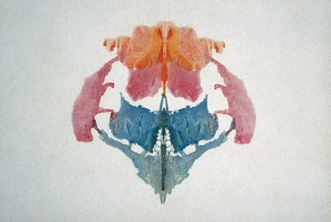

Psychoanalysis
© Spencer Grant/Photo
Researchers, Inc.
© Courtesy of Wordsworth Editions Ltd
© Stockbyte/Photos.com
L01
L02
L03
L04
L05
How Do Psychologists Provide Therapy?
What Different Types of
Psychotherapies Are Used?
What Are Biological Therapies?
How Are Specific Disorders Treated?
Notes:
Psychoanalysis is the original form of talk therapy, as conducted by Sigmund Freud and those trained in his tradition. Psychotherapy methods reflect the strong influence of the psychodynamic approach to personality, which assumes psychological symptoms are caused by unconscious aspects of personality (especially the id).
For this reason, the goal of psychoanalysis is insight, bringing the unconscious conflict into the conscious mind. Psychoanalysis also tends to emphasize forgotten traumatic experiences in childhood as a source of psychological symptoms. The assumption is that, once these traumas are remembered, the symptoms will disappear. Tools such as projective tests, free association, and dream analysis are often used with the aim of bringing unconscious material to the surface. The therapist’s role is to analyze the content of this material, and help guide the patient to insight.

Slide 11

Humanistic Therapies
The humanists believed that people are inherently good.
© Lisa F. Young/Photos.com
L01
L02
L03
L04
L05
How Do Psychologists Provide Therapy?
What Different Types of
Psychotherapies Are Used?
What Are Biological Therapies?
How Are Specific Disorders Treated?
Notes:
Whereas Freud believed that human nature was innately selfish and chaotic, the humanists believed that people are inherently good. As a result, the goal of humanistic therapy is to help people grow and improve – to “self-actualize.” This approach to psychotherapy emphasizes the importance of unconditional positive regard in helping the client to identify discrepancies between the ideal and real self, and resolve those discrepancies. The therapist’s role is to empathize with the client, reflecting and clarifying feelings.

Slide 12
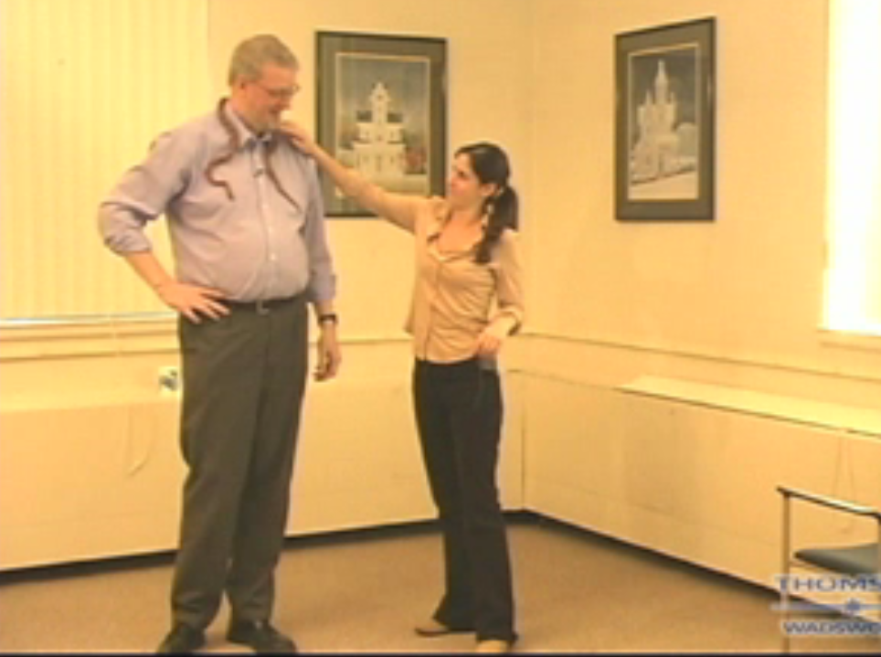

Behavior Therapies
Click on play button
to launch video in
QuickTime player.
L01
L02
L03
L04
L05
How Do Psychologists Provide Therapy?
What Different Types of
Psychotherapies Are Used?
What Are Biological Therapies?
How Are Specific Disorders Treated?
Notes:
Psychoanalysis and humanistic therapies both seek to develop the individual’s understanding of his or her situation by examining thoughts and feelings. Behavior therapies emerge from a very different perspective in Psychology, which emphasizes conditioned responses as a primary explanation for behavior. Consistent with this perspective, behavioral therapies seek to reduce unwanted behaviors by extinguishing their learned associations, and to increase desired behaviors by rewarding them. This video is about summer camps that offer intensive behavioral therapy for children with ADHD.

Slide 13
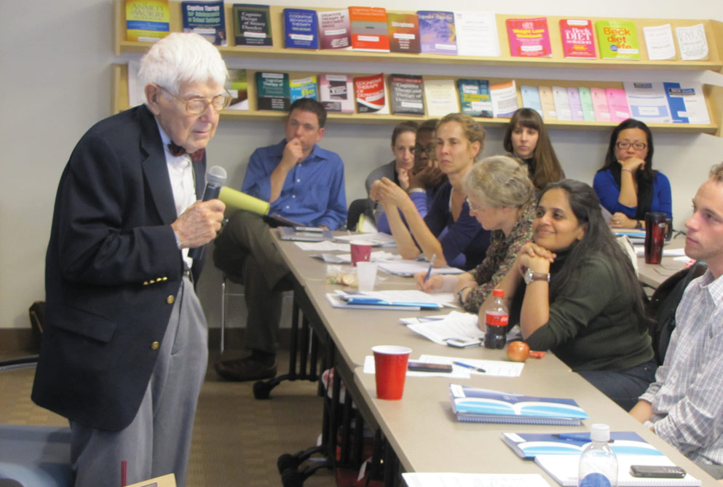
Cognitive Therapies
The aim of cognitive therapy is “cognitive restructuring.”
© Beck Institute for Cognitive Behavior Therapy, 2011
L01
L02
L03
L04
L05
How Do Psychologists Provide Therapy?
What Different Types of
Psychotherapies Are Used?
What Are Biological Therapies?
How Are Specific Disorders Treated?
Notes:
Cognitive therapies emphasize the role beliefs and cognitive biases can play in driving our emotions and actions. Aaron Beck, shown here, was a pioneer in cognitive therapy. According to Beck, psychological disorders – especially mood and anxiety disorders – often result from irrational and self-defeating expectations and ways of thinking. The aim of cognitive therapy is “cognitive restructuring,” in which irrational belief systems are replaced with rational ones as a result of logical analysis of the problems.

Slide 14
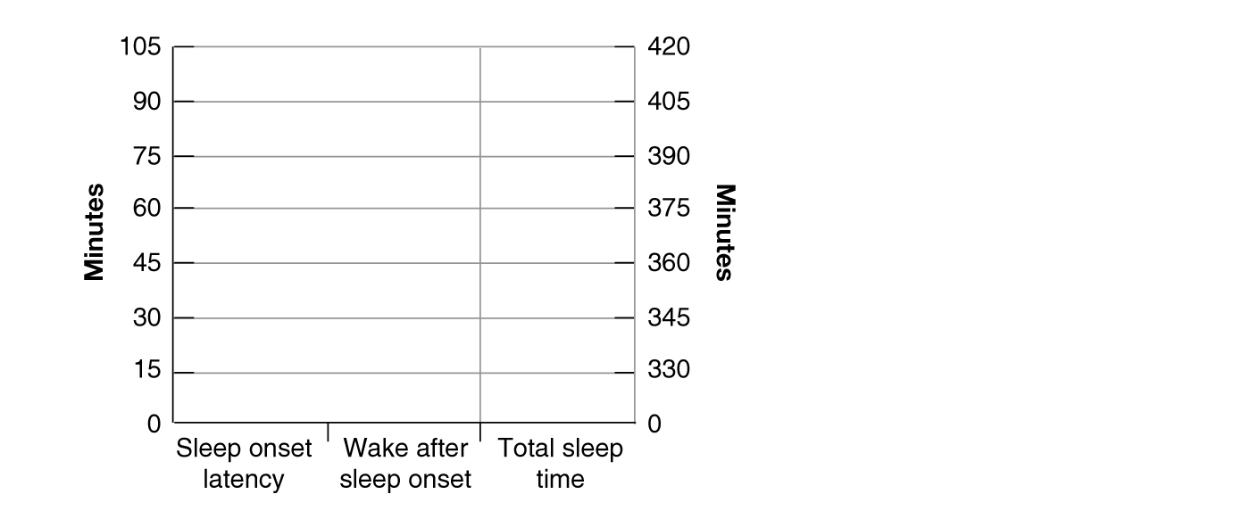
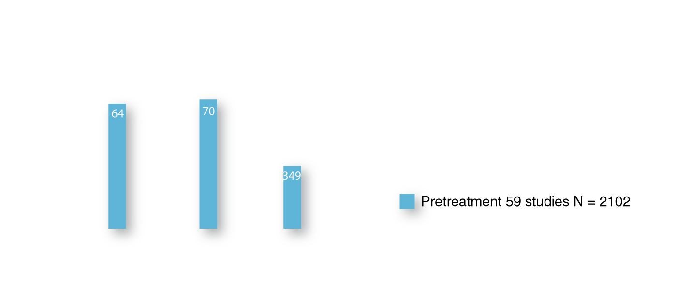
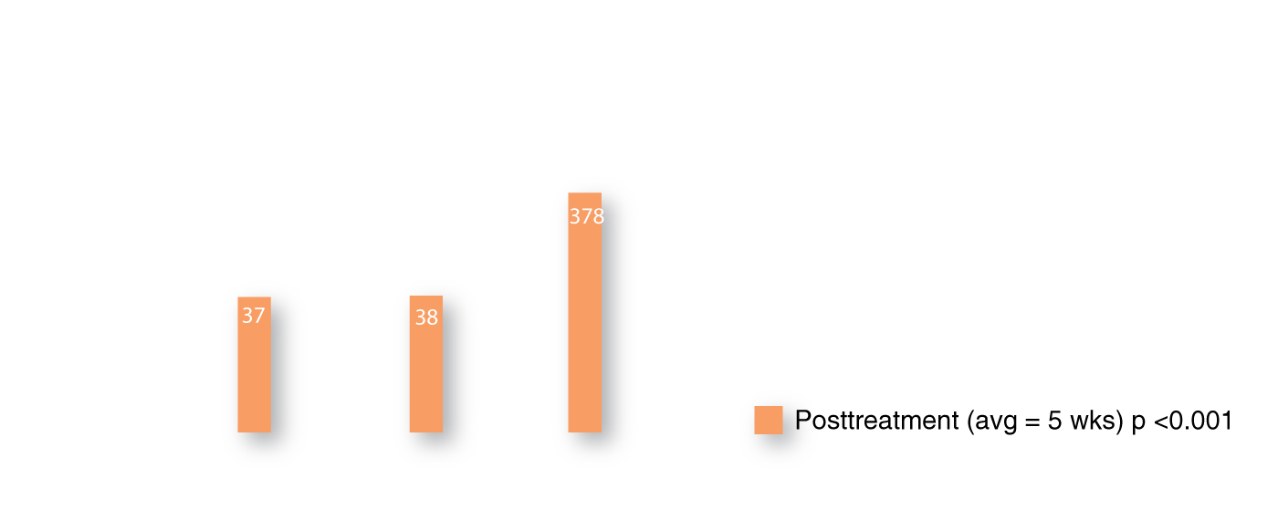
Cognitive-Behavioral
Therapy (CBT)
© Cengage Learning 2013
L01
L02
L03
L04
L05
How Do Psychologists Provide Therapy?
What Different Types of
Psychotherapies Are Used?
What Are Biological Therapies?
How Are Specific Disorders Treated?
Notes:
Many disorders include both cognitive and behavioral aspects. As a result, modern therapists often emphasize a combination of cognitive restructuring and direct behavior modification, called Cognitive-Behavioral Therapy. Studies have found CBT to be effective in treating a variety of disorders, especially depression and anxiety, but also other problems as well. In this study CBT effectively improved insomnia both immediately after treatment and five weeks later.

Slide 15
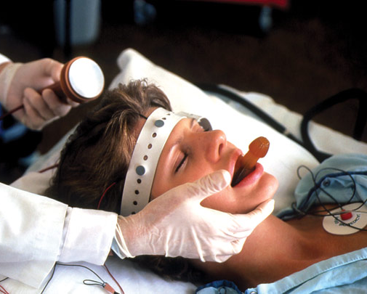
What Are Biological
Therapies?
L01
L02
L03
L04
Explain the biological mechanisms by which medication, electro-convulsive therapy (ECT), psychosurgery, deep brain stimulation,
and bio/neurofeedback are thought to alleviate symptoms of disorder.
L05
Notes:
LO4: Explain the biological mechanisms by which medication, electroconvulsive therapy (ECT), psychosurgery, deep brain stimulation, and bio/neurofeedback are thought to alleviate symptoms of disorder.

Slide 16
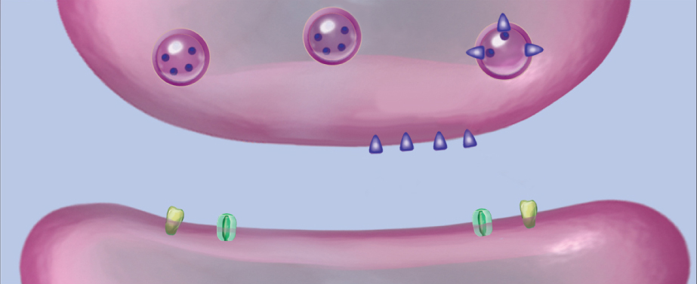
Medication
Reuptake
Inhibitors
M
Receptor
Blockers
Receptor
Agonists
M
M
M
Neurotransmitter
Breakdown
M
M
© Argosy Publishing, Inc.
L01
L02
L03
L04
L05
How Do Psychologists Provide Therapy?
What Different Types of
Psychotherapies Are Used?
What Are Biological Therapies?
How Are Specific Disorders Treated?
Notes:
Medications for psychological disorders typically work by altering neurotransmission, much like psychoactive drugs. Medications may either increase or decrease activation of receptors for a particular neurotransmitter. For example, medications may increase activity by directly activating receptors, or by blocking reuptake channels, leaving neurotransmitters in the synapse for a longer period of time. Medications may decrease activity by blocking receptors without activating them, or by speeding up the breakdown of the neurotransmitters.
The history of psychiatric medication includes a great deal of trial-and-error, and the mechanisms by which medications work are often still unknown. Medications should be taken only under careful medical supervision, when clearly indicated by and approved for specific symptoms, in the smallest dose necessary, and monitoring for side effects and possible dependence.

Slide 17

Electroconvulsive Therapy (ECT)
ECT is used to treat severe mood disorders that do not respond to other treatments.
© Will McIntyre/Photo Researchers, Inc.
L01
L02
L03
L04
L05
How Do Psychologists Provide Therapy?
What Different Types of
Psychotherapies Are Used?
What Are Biological Therapies?
How Are Specific Disorders Treated?
Notes:
ECT is a treatment in which the patient is anaesthetized and given a muscle relaxant, and then electric pulses are used to induce a seizure. Although ECT was first attempted with schizophrenic patients in the 1930s, with poor results, it is now used to treat severe mood disorders that do not respond to other treatments. While the exact mechanism of ECT is unknown, patients often show increased responsiveness to dopamine and norepinephrine after the treatment, and these neurotransmitters are associated with feelings of energy and reward.

Slide 18

Psychosurgery
Psychosurgery has a troubled history, but is still used to treat epilepsy and OCD.
© VILevi/Photos.com
L01
L02
L03
L04
L05
How Do Psychologists Provide Therapy?
What Different Types of
Psychotherapies Are Used?
What Are Biological Therapies?
How Are Specific Disorders Treated?
Notes:
Like ECT, neurosurgery for the treatment of psychological disorder has a troubled history. Tens of thousands of patients received frontal lobotomies, or surgical removal of brain tissue in the frontal lobes, during the mid-20th century. Results were often disastrous, as the frontal lobes are now known to support many important higher cognitive processes. Modern psychiatry reserves the use of very small, precisely placed lesions to help alleviate severe symptoms of epilepsy and OCD that do not respond to other treatments, literally cutting off overactive areas of the brain.

Slide 19

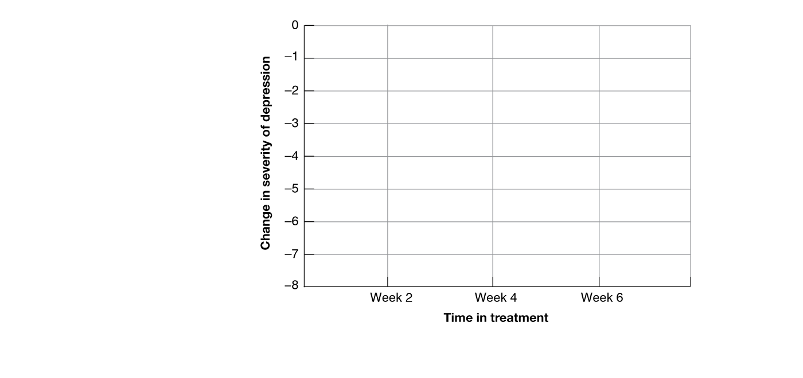


Deep Brain Stimulation
© Dan Dunkley/Photo Researchers, Inc.
© Cengage Learning 2013
L01
L02
L03
L04
L05
How Do Psychologists Provide Therapy?
What Different Types of
Psychotherapies Are Used?
What Are Biological Therapies?
How Are Specific Disorders Treated?
Notes:
When the neural roots of a problem involve inadequate activation, as is Parkinson’s Disease and perhaps depression, it may be possible to stimulate this activity artificially. One approach uses microelectrode implants to target specific areas of the brain. Another approach uses low-frequency transcranial magnetic stimulation (TMS) to temporarily increase activity deep in the brain. One study compared the impact of TMS on depression symptoms over a 6 week period, finding significant improvement compared with a “sham TMS” control group.

Slide 20

Neurofeedback
Neurofeedback is sometimes used with children with ADHD.
© Dr. Lise DeLong/cognitive-connections.com
L01
L02
L03
L04
L05
How Do Psychologists Provide Therapy?
What Different Types of
Psychotherapies Are Used?
What Are Biological Therapies?
How Are Specific Disorders Treated?
Notes:
Biofeedback and neurofeedback both provide information to the individual about the state of the body/brain, potentially allowing the individual to control those functions. Although the treatment is still highly experimental, neurofeedback is sometimes used with children with ADHD.

Slide 21
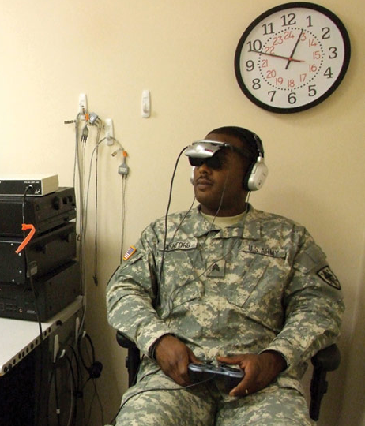
How Are Specific Disorders Treated?
L01
L02
L03
L04
L05
Integrate biological and psychotherapeutic approached to treating anxiety, mood, dissociative, somatoform, schizophrenic, personality,
and childhood disorders, explaining how they work together in the
context of a particular disorder.
Notes:
LO5: Integrate biological and psychotherapeutic approached to treating anxiety, mood, dissociative, somatoform, schizophrenic, personality, and childhood disorders, explaining how they work together in the context of a particular disorder.

Slide 22

Anxiety Disorders: CBT
Photo by Stephen Dagadakis, © Hunter
Hoffman www.vrpain.com, World built by
Firsthand Inc.
Phobias are treated via systematic desensitization
or “exposure” therapy.
L01
L02
L03
L04
L05
How Do Psychologists Provide Therapy?
What Different Types of
Psychotherapies Are Used?
What Are Biological Therapies?
How Are Specific Disorders Treated?
Notes:
Psychotherapy treatments for anxiety disorders often emphasize behavioral or cognitive-behavioral approaches. Phobias area treated via systematic desensitization or “exposure” therapy, in which the client is exposed to increasing levels of exposure to the phobic target, and allowed to reach a level of comfort with each step before moving on to the next. Behavioral therapy for OCD might involve anticipating compulsions, and replacing that behavior with a competing one.

Slide 23
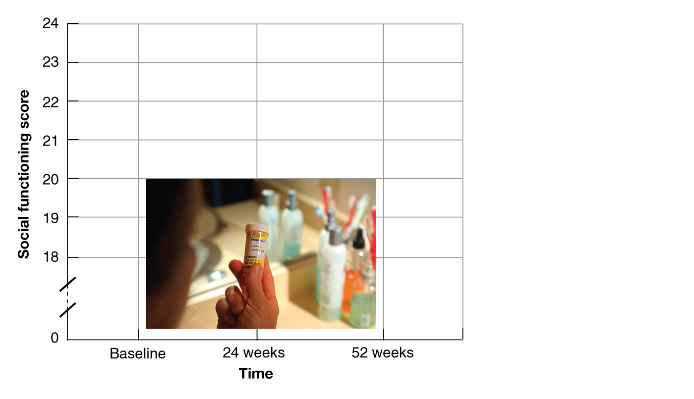
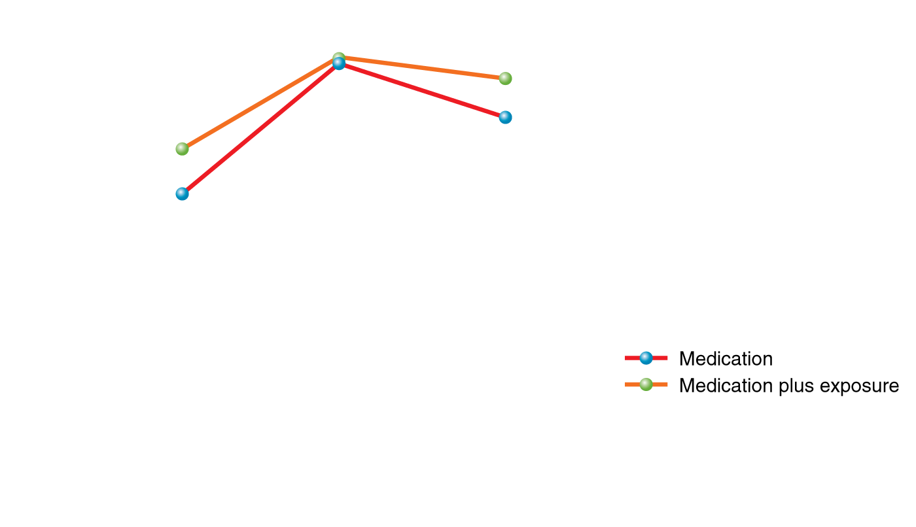


Anxiety Disorders: Medication
Illustration: © Cengage Learning 2013; photo: © Liquidlibrary/Photos.com
L01
L02
L03
L04
L05
How Do Psychologists Provide Therapy?
What Different Types of
Psychotherapies Are Used?
What Are Biological Therapies?
How Are Specific Disorders Treated?
Notes:
Traditional anxiolytic, or anxiety-reducing, medications such as the benzodiazepines are GABA agonists. Because GABA is a major inhibitory neurotransmitter, GABA agonists tend to reduce overall arousal in the brain, including the arousal linked to anxiety. As a result, Valium and other benzodiazepines tend to slow down all aspects of brain activity and reduce alertness, and they are also potentially addictive. In recent years SSRIs (originally used to treat depression) have also been effective in alleviating anxiety symptoms for some people, for reasons not yet understood.

Slide 24

Major Depression: CBT
CBT is a common and effective treatment for depression.
© nullplus/iStockphoto
L01
L02
L03
L04
L05
How Do Psychologists Provide Therapy?
What Different Types of
Psychotherapies Are Used?
What Are Biological Therapies?
How Are Specific Disorders Treated?
Notes:
CBT treatment for depression seeks to increase activity and social skills, while also targeting beliefs that support learned helplessness, powerlessness, hopelessness, and low self-worth, replacing them with more balanced beliefs. Between 40-60% of people treated with CBT not only experience short-term relief, but also show greater protection against future episodes than those treated with medication alone.

Slide 25
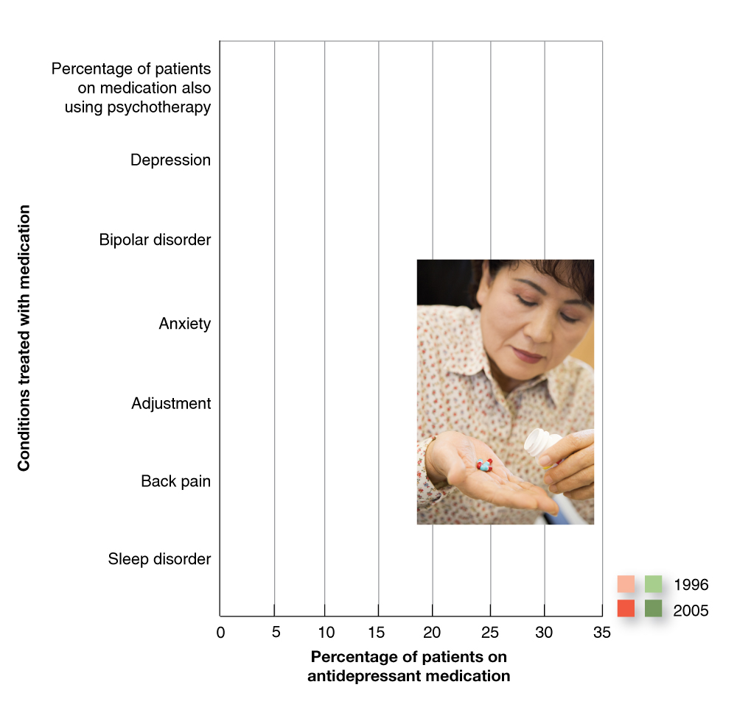







Major Depression: Medication
Illustration: © Cengage Learning 2013
Photo: © Monkey Business Images/Shutterstock
L01
L02
L03
L04
L05
How Do Psychologists Provide Therapy?
What Different Types of
Psychotherapies Are Used?
What Are Biological Therapies?
How Are Specific Disorders Treated?
Notes:
Medications for depression typically aim to increase activation of receptors for monoamine neurotransmitters, such as dopamine and serotonin. One very popular kind of antidepressant is the Selective Serotonin Reuptake Inhibitor, or SSRI. These medications block serotonin reuptake channels in the presynaptic membrane, leaving serotonin in the synapse for a longer period of time. Randomized controlled trials find that SSRIs have effects on depression starting 2-3 weeks after treatment. This suggests that the effects of the drug are not due to increased serotonin alone, but rather to a downstream effect of the increased serotonin on neural chemistry. Researchers are still studying the exact mechanisms behind effectiveness of SSRIs.

Slide 26


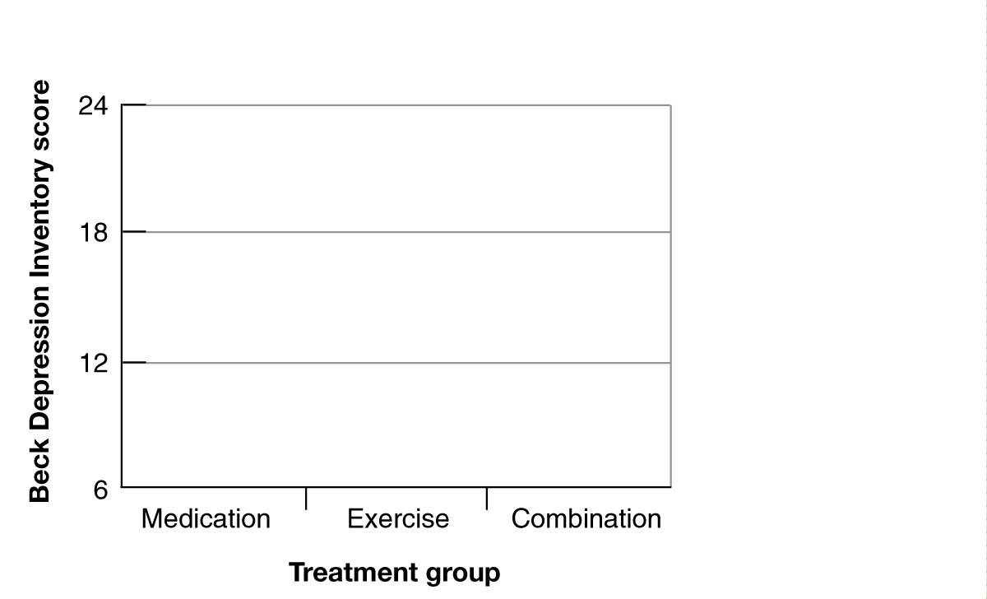
Major Depression: Exercise
Illustration: © Cengage Learning 2013; photo: © Jupiterimages/Photos.com
L01
L02
L03
L04
L05
How Do Psychologists Provide Therapy?
What Different Types of
Psychotherapies Are Used?
What Are Biological Therapies?
How Are Specific Disorders Treated?
Notes:
While psychotherapy and medication can be important parts of the treatment plan for depression, moderate amounts of aerobic exercise also lead to considerable relief from symptoms.

Slide 27
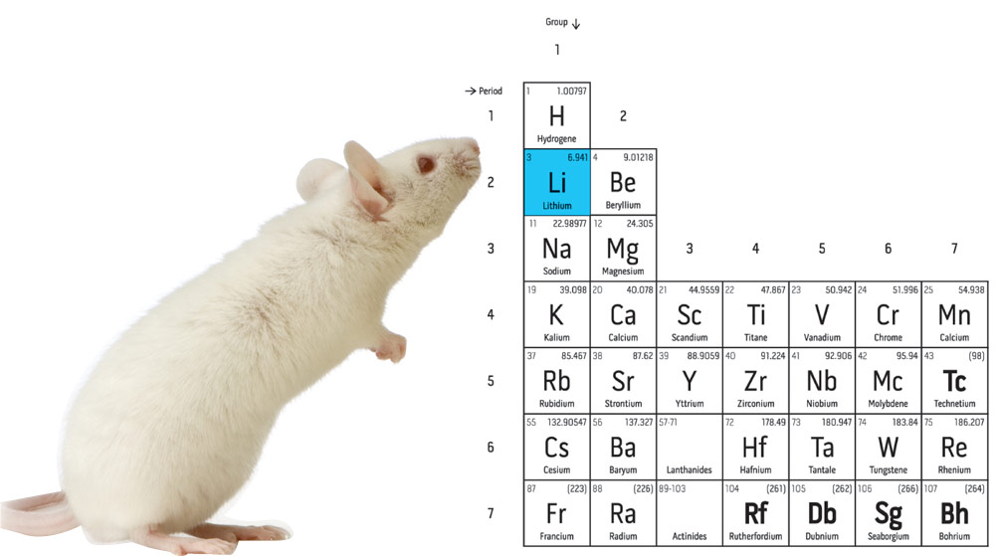
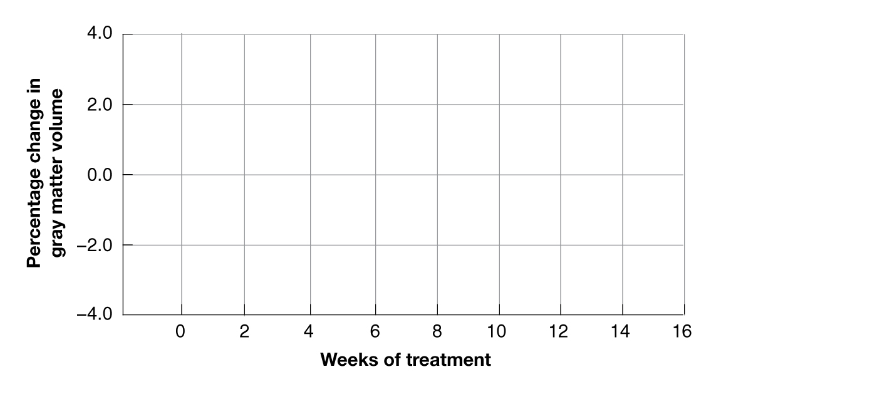
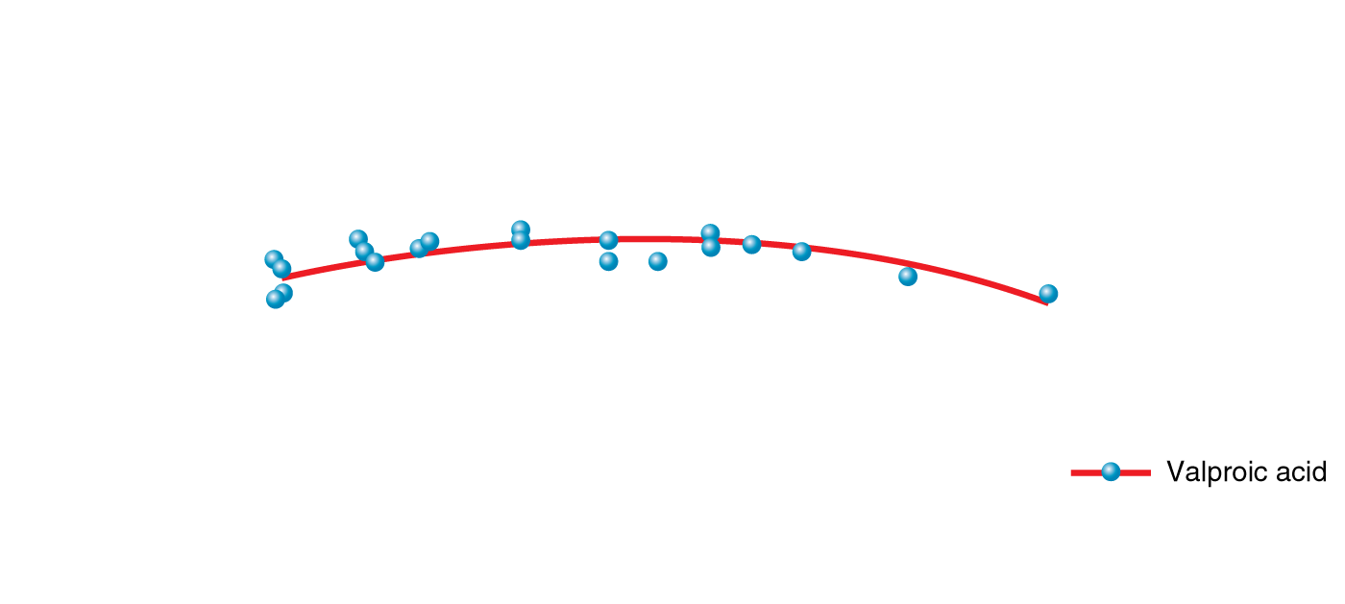
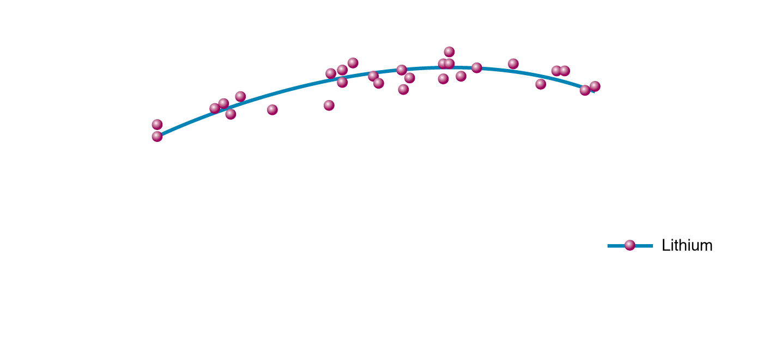
Bipolar Disorder: Lithium
Mouse: © Eric Isselée/Shutterstock
Periodic table: © Ron Dale/Shutterstock
© Cengage Learning 2013
L01
L02
L03
L04
L05
How Do Psychologists Provide Therapy?
What Different Types of
Psychotherapies Are Used?
What Are Biological Therapies?
How Are Specific Disorders Treated?
Notes:
The primary treatment for bipolar disorder is lithium, an element used as a medication. The mechanisms behind the effectiveness of the drug are not well understood, but studies do suggest that gray matter cell growth may be involved. Unfortunately, side effects of lithium include nausea, muscle tremor, and seizures.

Slide 28

Dissociative Identity
Disorder: Hypnosis
Hypnosis is at least as controversial as the diagnosis itself.
© selimaksan/iStockphoto
L01
L02
L03
L04
L05
How Do Psychologists Provide Therapy?
What Different Types of
Psychotherapies Are Used?
What Are Biological Therapies?
How Are Specific Disorders Treated?
Notes:
Psychoanalysts in the Freudian tradition often work under the assumption that DID symptoms are due to forgotten childhood experience of abuse. These therapists are may use hypnosis as a way to access such memories, but this treatment at least as controversial as the diagnosis itself. Studies find that hypnotized individuals are vulnerable to implanting of new, false memories, and those who show DID symptoms appear to be especially vulnerable to suggestion.

Slide 29

Somatoform Disorders: CBT
CBT guides the client through restructuring
of their self-perceptions.
© Ed Young/Photo Researchers, Inc.
L01
L02
L03
L04
L05
How Do Psychologists Provide Therapy?
What Different Types of
Psychotherapies Are Used?
What Are Biological Therapies?
How Are Specific Disorders Treated?
Notes:
Body dysmorphic disorder is often treated using CBT, which guides the client through restructuring of their self-perceptions. Somatoform disorders involving pain or unexplained symptoms are difficult to treat because most patients are diagnosed by a primary care physician, and refuse to see a psychologist or other psychotherapist.

Slide 30
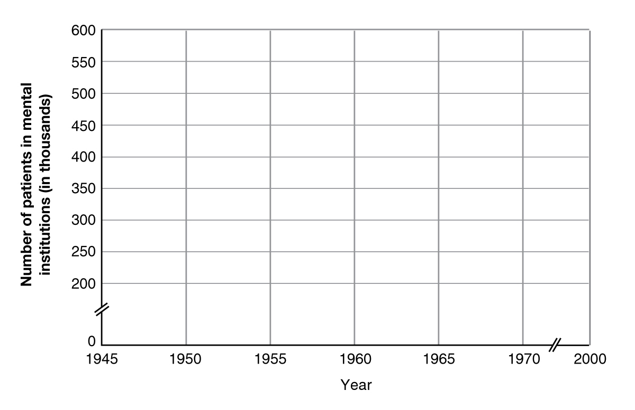

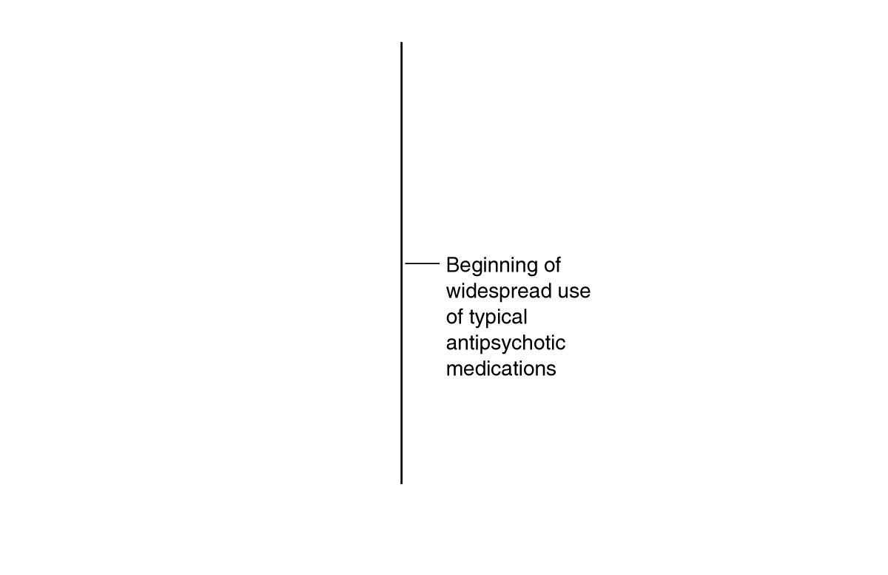
Schizophrenia: Medication
© Cengage Learning 2013
Year
L01
L02
L03
L04
L05
How Do Psychologists Provide Therapy?
What Different Types of
Psychotherapies Are Used?
What Are Biological Therapies?
How Are Specific Disorders Treated?
Notes:
Phenothiazines (e.g., thorazine) are dopamine receptor blockers. These medications, often referred to as “antipsychotics,” are effective in treating delusions and hallucinations, but less have less impact on other symptoms. Because dopamine is involved in a wide range of neural processes, the mechanism of action produces unpleasant side effects such as depressed mood (because dopamine is the primary neurotransmitter in reward circuits), and Parkinson’s-like motor problems known as Tardive Dyskinesia (because dopamine is involved in fine motor control as well).
Newer “atypical” antipsychotics affect a wider range of neurotransmitter mechanisms, and are better at managing negative symptoms, though they have their own profile of side effects.

Slide 31

Antisocial Personality Disorder: ???
Researchers have not yet identified an effective treatment for APD.
© Josh Rinehults/Photos.com
L01
L02
L03
L04
L05
How Do Psychologists Provide Therapy?
What Different Types of
Psychotherapies Are Used?
What Are Biological Therapies?
How Are Specific Disorders Treated?
Notes:
Unfortunately, researchers have not yet identified an effective treatment for APD. Medications have not been approved for the specific symptoms, though tranquilizers are sometimes prescribed to make patients more manageable. Talk therapies are not effective with those who show true symptoms of psychopathy; the effort is complicated by fact that patients don’t think there’s anything wrong with them, and may try to manipulate the therapist.

Slide 32

Borderline Personality
Disorder: CBT
Dialectical Behavior Therapy uses diary methods, even
by smartphone.
© Cengage Learning 2013
L01
L02
L03
L04
L05
How Do Psychologists Provide Therapy?
What Different Types of
Psychotherapies Are Used?
What Are Biological Therapies?
How Are Specific Disorders Treated?
Notes:
CBT for BPD is aimed at developing emotion regulation and stress management skills. In particular, Dialectical Behavior Therapy uses diary methods (even by smartphone) to help clients become more mindful and accepting of their emotions. No medications have been approved for BPD, but antidepressants and anxiolytics are sometimes prescribed to help manage emotional symptoms.

Slide 33
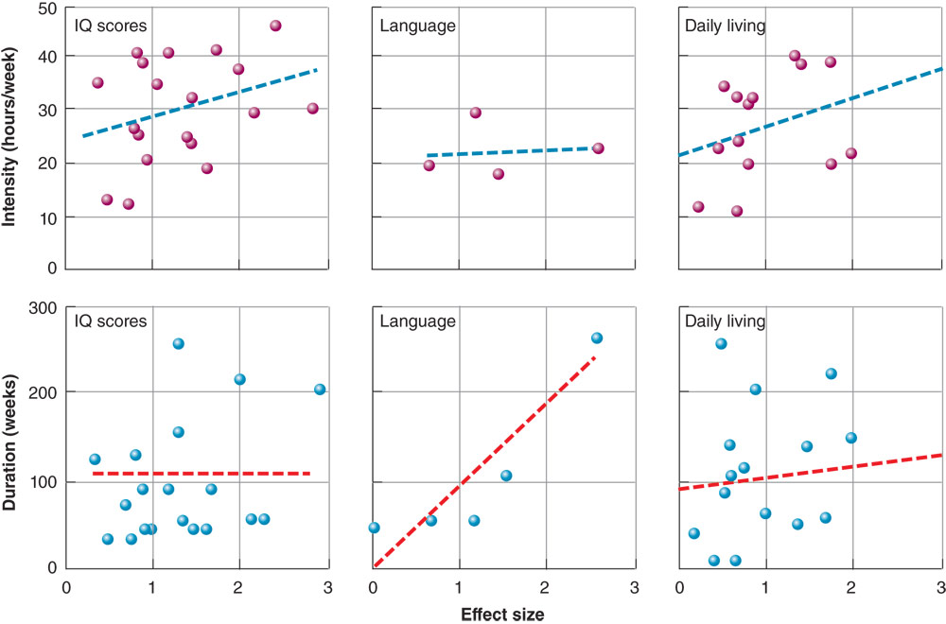
Autism: Behavior Modification
© Cengage Learning 2013
L01
L02
L03
L04
L05
How Do Psychologists Provide Therapy?
What Different Types of
Psychotherapies Are Used?
What Are Biological Therapies?
How Are Specific Disorders Treated?
Notes:
The most common and best scientifically supported treatment for autism involves behavioral therapies based in operant conditioning principles, which reward desired behavior and seek to develop skills and habits through extensive training. Although doctors may prescribe a variety of medications, there is no scientific evidence that most work, and they are not approved for this use. Only risperidone (an atypical antipsychotic) seems to help patients tending to self-injure, but has no effect on other symptoms. No evidence yet for dietary changes, oxygen therapy, other commonly advertised treatments.

Slide 34

ADHD: Medication
© Cengage Learning 2013
L01
L02
L03
L04
L05
How Do Psychologists Provide Therapy?
What Different Types of
Psychotherapies Are Used?
What Are Biological Therapies?
How Are Specific Disorders Treated?
Notes:
At this time, medication is the primary treatment for ADHD - specifically Ritalin and related stimulants. Although it may seem counterintuitive to prescribe a stimulant for hyperactivity, these drugs increase dopamine activity in the frontal lobes, an area of the brain that mediates inhibitory self-control, planning, reasoning, and other cognitive functions that are impaired in ADHD. However, this mechanism leads to increased concern about inappropriate prescription of the drug, as stimulants have to potential to be addictive, and have a variety of side effects. Behavioral methods using conditioning to promote desired behaviors are also being developed, see slide 12.

